Slide 1
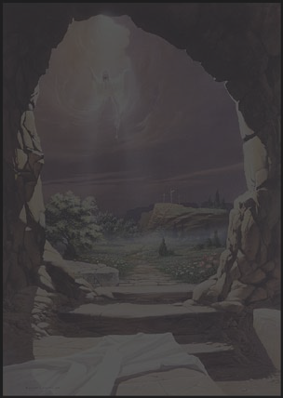

Sunday April 8th, 2012

Slide 2

Told from 4 Unique Perspectives

Slide 3

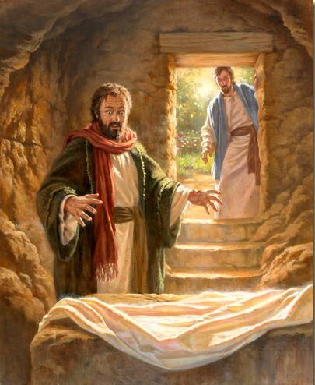
One of the most written of apostles in gospels and Acts
A close companion to Jesus
Suffered with shame and regret
He wondered at the empty tomb (Luke 24:12)

Slide 4
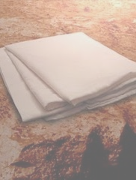
He was the first of the twelve to see the risen Christ (1 Cor. 15:5)
He found the folded napkin (John 20:7)
Often if not always included the resurrection in his sermons

Slide 5

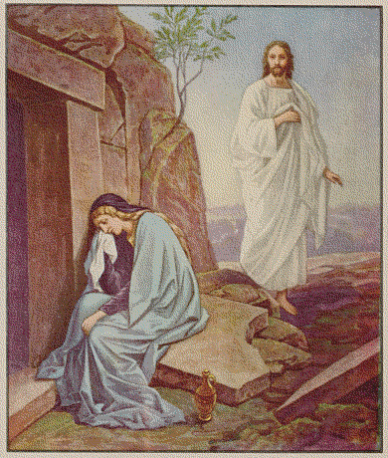
She sought
John 20:1
She wept
John 20:11
She lingered
John 20:11

Slide 6

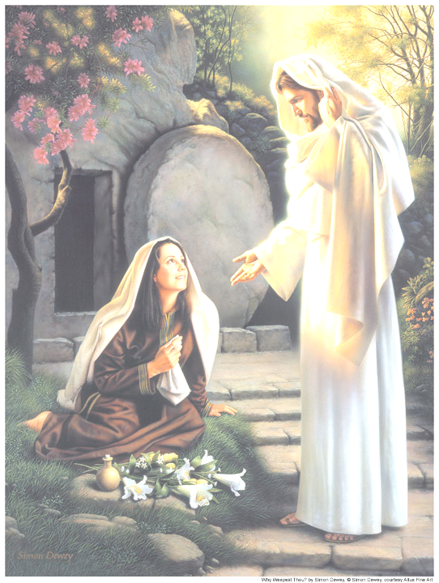
She supposed
John 20:15
She turned
John 20:16
She saw
John 20:18

Slide 7

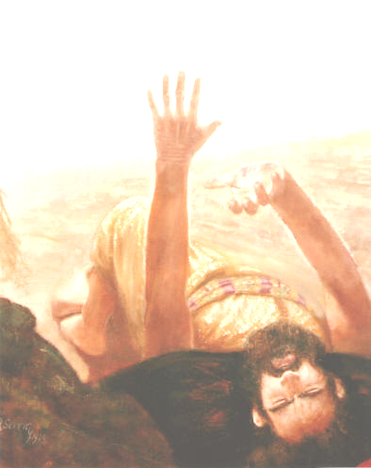
Unique witness on Damascus road
1 Cor. 15:1-58
Witness of the Scriptures
The Eyewitnesses
  Peter, James, Paul
  500+ more!
His writing and preaching

Slide 8


Slide 9
        ?

Slide 10

Romans 10:9 “that if thou shalt confess with thy mouth Jesus as Lord, and shalt believe in thine heart that God has raised him from among the dead, thou shalt be saved.
Romans 6:4 “as Christ has been raised up from among the dead by the glory of the Father, so we also should walk in newness of life.”

Slide 11

John 2:19 "Destroy this temple, and in three days I will raise it up”
John 10:17-18 "I lay down My life, that I might take it again ... I have power to lay it down, and I have power to take it again”

Slide 12

John 6:63 “But "it is the Spirit that makes alive”
1 Peter 3:18 “for Christ indeed has once suffered for sins, the just for the unjust, that he might bring us to God; being put to death in flesh, but made alive in the Spirit.”

Slide 13
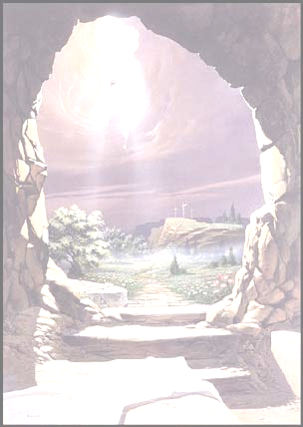
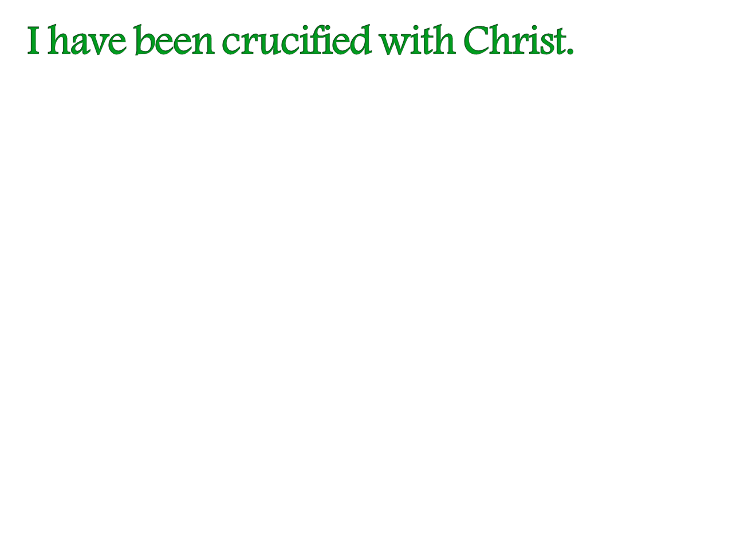

Slide 14
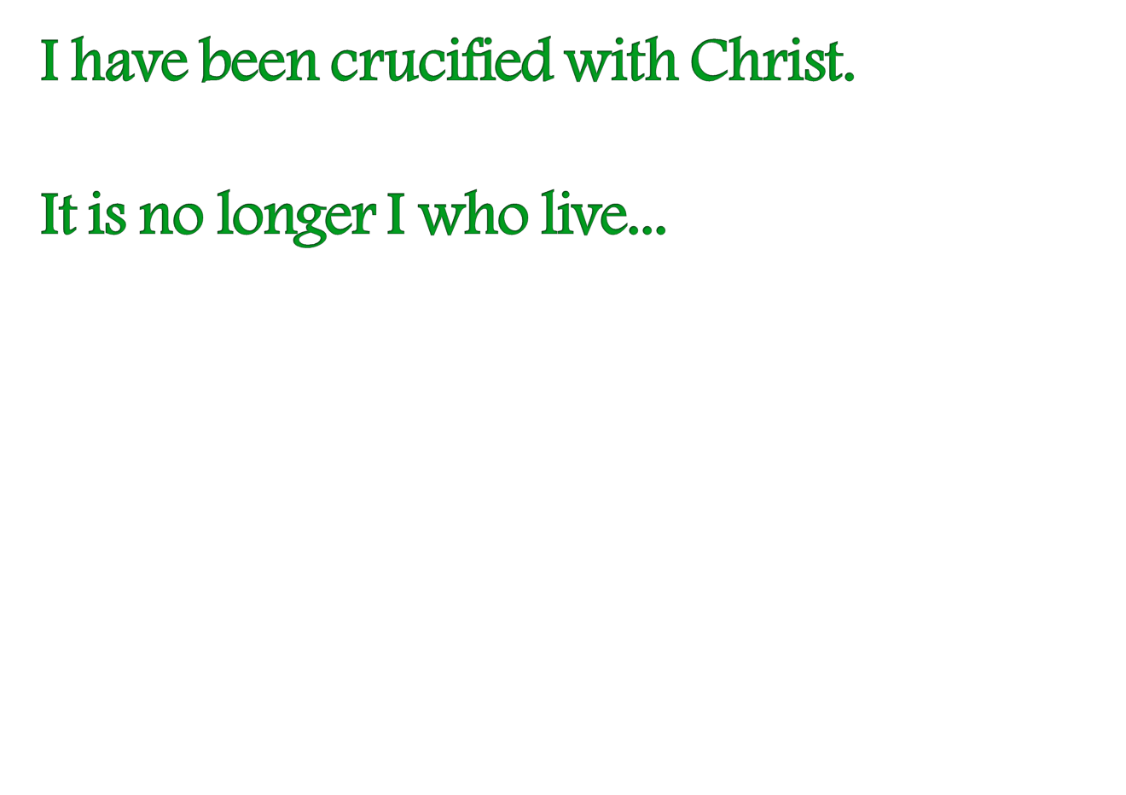

Slide 15
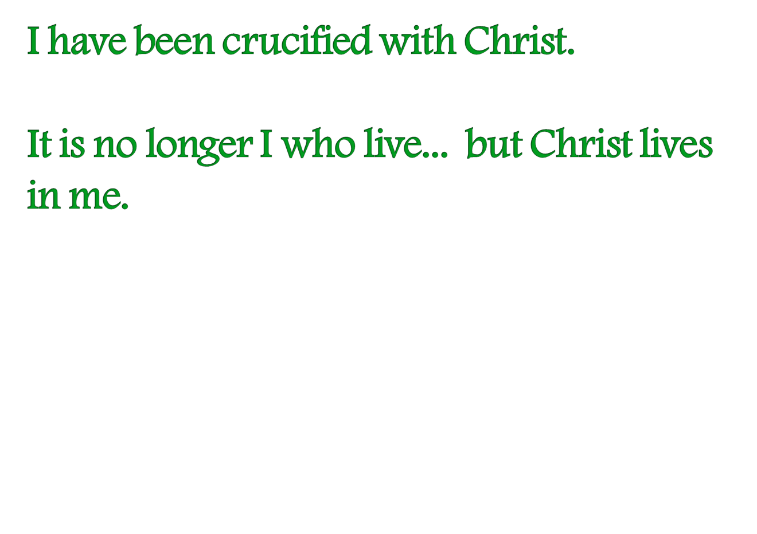

Slide 16
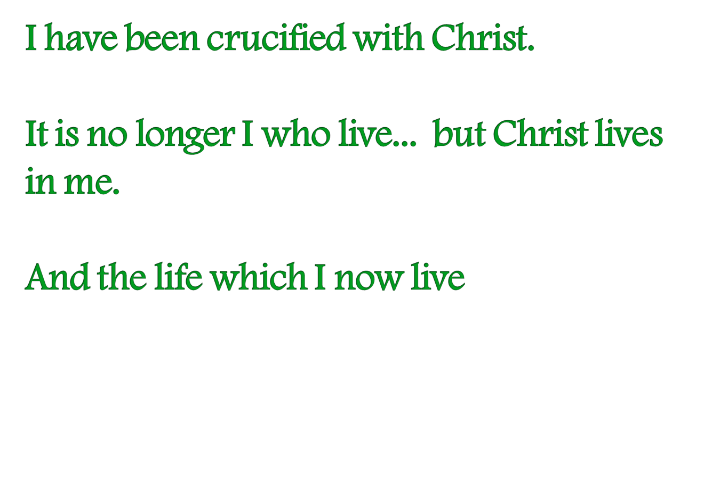

Slide 17
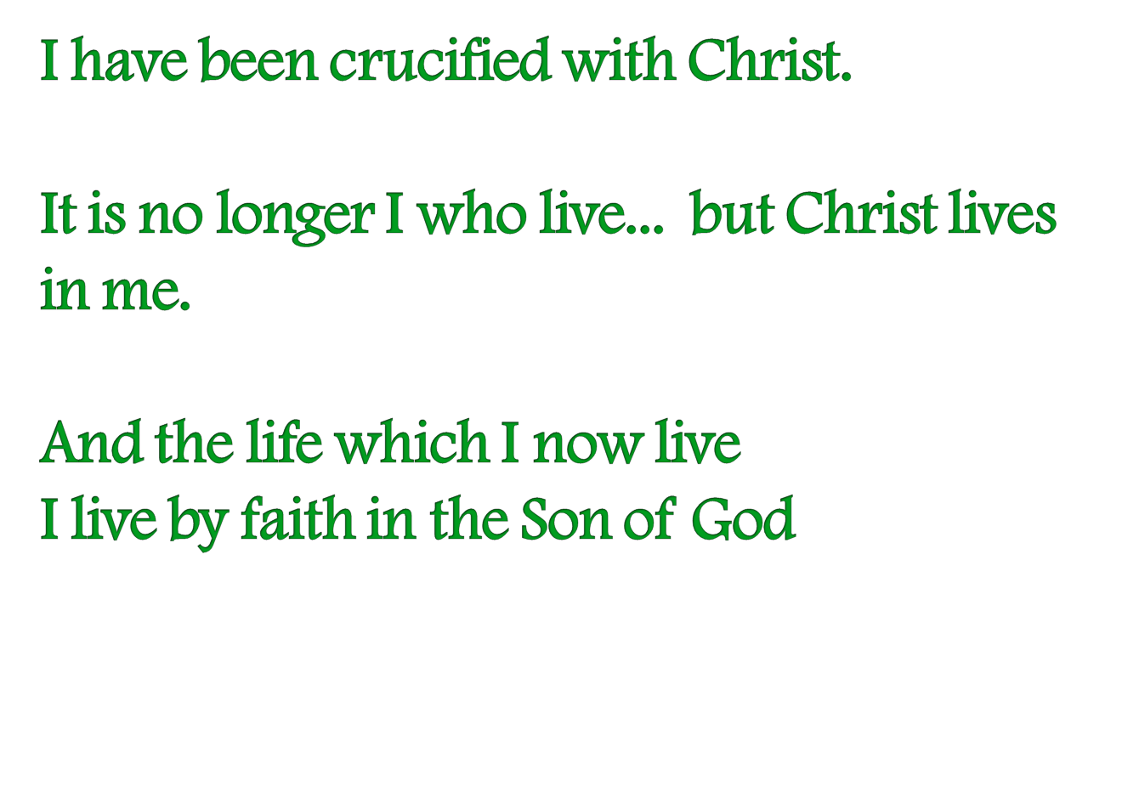

Slide 18
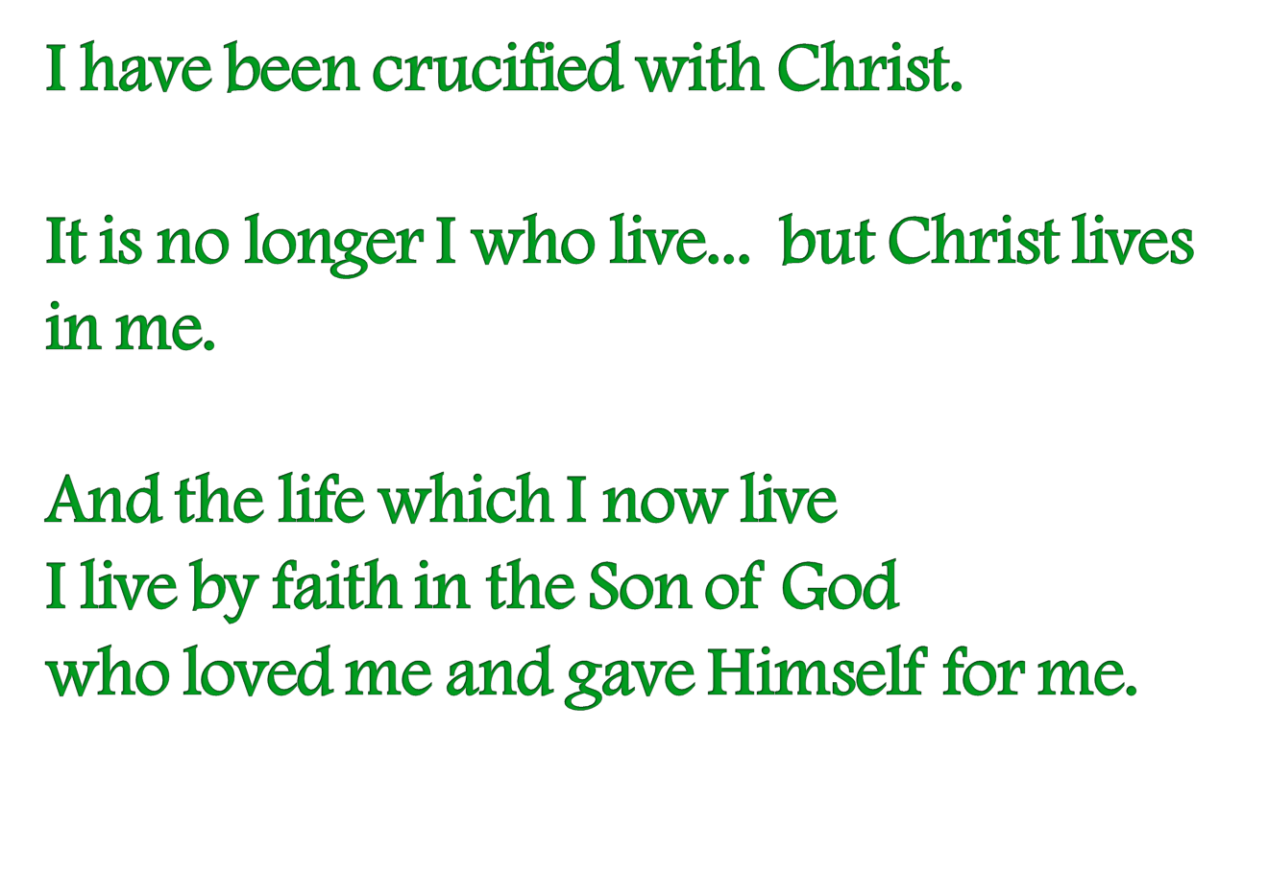

Slide 19
